Slide 1
Problem Statement
Exercise 1
Transform the following formula into prenex, Skolem and clausal normal forms.
3. U₃ = (∀x)(∃y)((∃z)P(z, x) (∀u)(Q(x, u) ᴧ (∃z) ¬ R(y, z)))

Slide 2
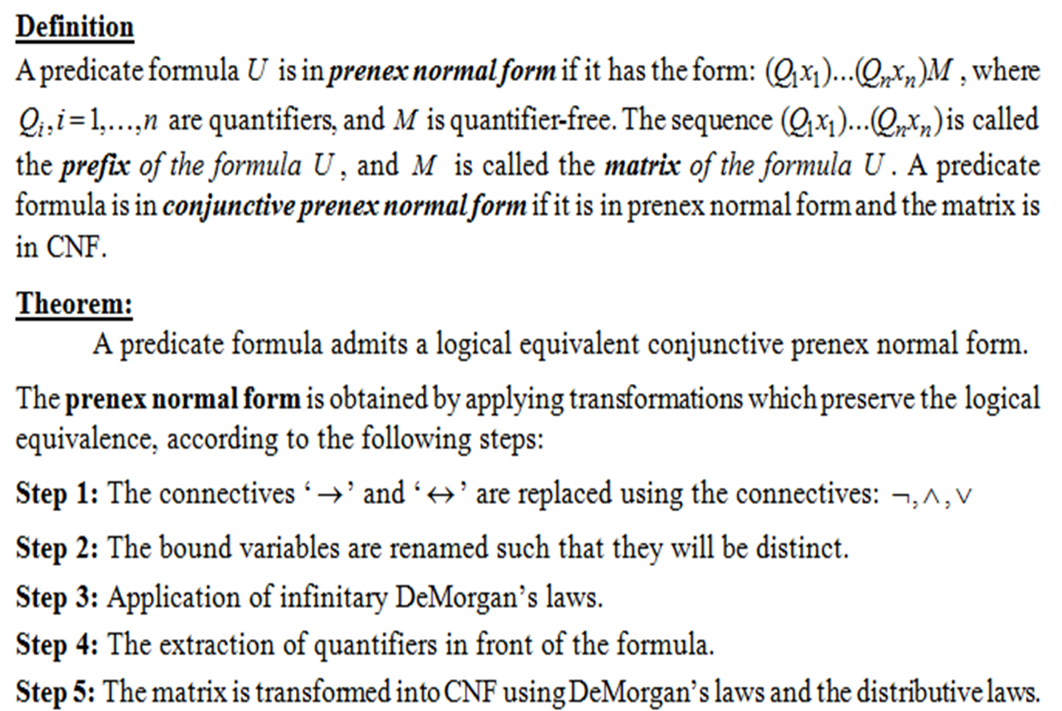
Theoretical Results
Prenex normal form

Slide 3
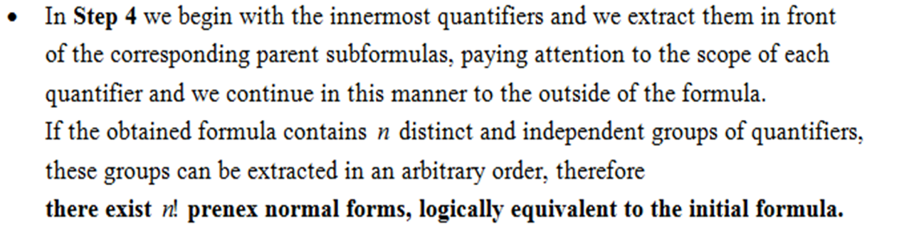
Remark:

Slide 4
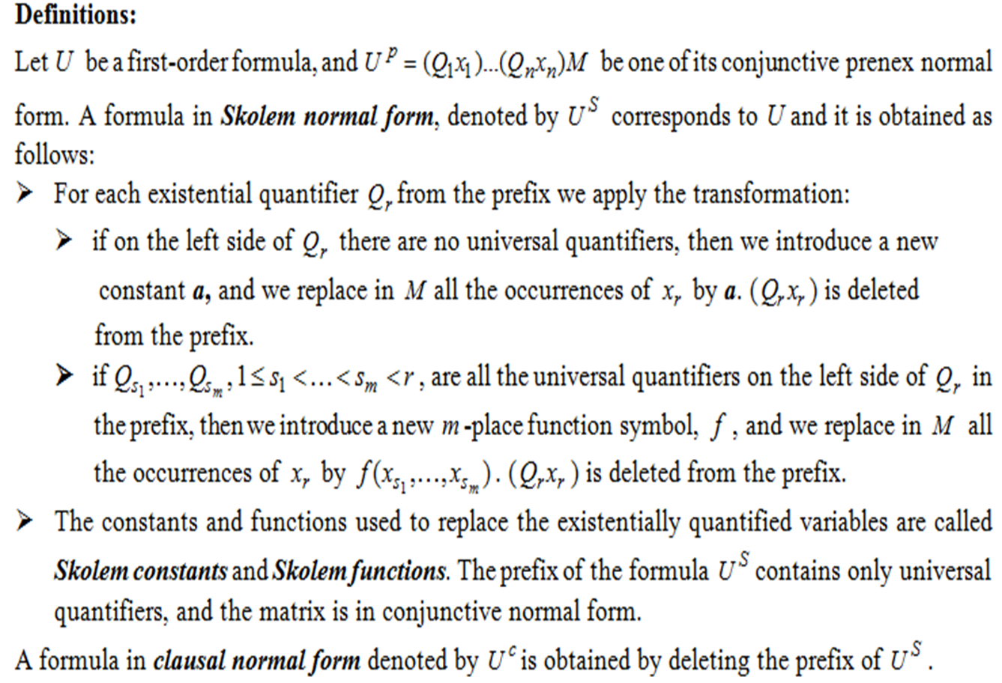
Skolem and clausal normal forms

Slide 5
U₃ = (∀x)(∃y)((∃z)P(z, x) → (∀u)(Q(x, u) ᴧ (∃z) ¬ R(y, z)))
Replace ‘ → ‘ connective: A → B ≡ ¬ A ∨ B
U₃ ≡ (∀x)(∃y)(¬(∃z)P(z, x) ∨ (∀u)(Q(x, u) ᴧ (∃z) ¬ R(y, z)))
Rename the bound variables:
U₃ ≡ (∀x)(∃y)(¬(∃z)P(z, x) ∨ (∀u)(Q(x, u) ᴧ (∃t) ¬ R(y, t)))
Apply DeMorgan’s infinitary law: ¬(∃x)A(x) ≡ (∀x) ¬A(x)
U₃ ≡ (∀x)(∃y)((∀z) ¬ P(z, x) ∨ (∀u)(Q(x, u) ᴧ (∃t) ¬ R(y, t)))
Extract quantifiers in front of the formula in two different ways:
U₃ ≡ (∀x)(∃y)((∀z)¬ P(z, x) ∨ (∀u)(∃t) (Q(x, u) ᴧ ¬ R(y, t)))
U₃ ≡ (∀x)(∃y)(∀z)(∀u)(∃t) (¬ P(z, x) ∨ (Q(x, u) ᴧ ¬ R(y, t)))
U₃ ≡ (∀x)(∃y)(∀u)(∃t)(∀z) (¬ P(z, x) ∨ (Q(x, u) ᴧ ¬ R(y, t)))
Apply the distributive law of ∨ over ᴧ in order to transform the matrix into CNF and the prenex normal form of U₃ are:
U₃ ≡ (∀x)(∃y)(∀z)(∀u)(∃t) ((¬ P(z, x) ∨ Q(x, u)) ᴧ (¬ P(z, x) ∨ ¬ R(y, t))) = U₁^{p}
U₃ ≡ (∀x)(∃y)(∀u)(∃t)(∀z) ((¬ P(z, x) ∨ Q(x, u)) ᴧ (¬ P(z, x) ∨ ¬ R(y, t))) = U₂^{p}

Slide 6
U₁^{p} = (∀x)(∃y)(∀z)(∀u)(∃t) ((¬ P(z, x) ∨ Q(x, u)) ᴧ (¬ P(z, x) ∨ ¬ R(y, t)))
Skolemization process applied to formula U₁^{p} => Skolem form
U₁^{S} = (∀x)(∀z)(∀u)((¬ P(z, x) ∨ Q(x, u)) ᴧ (¬ P(z, x) ∨ ¬ R(f(x), g(x, z, u))))
[y <- f(x)], f is a unary Skolem function
[t <- g(x, z, u)], g is a Skolem function
We obtain the clausal normal form by deleting the prefix of U₁^{S}
U₁^{c} = (¬ P(z, x) ∨ Q(x, u)) ᴧ (¬ P(z, x) ∨ ¬ R(f(x), g(x, z, u)))

Slide 7
U₂^{p} = (∀x)(∃y)(∀u)(∃t)(∀z) ((¬ P(z, x) ∨ Q(x, u)) ᴧ (¬ P(z, x) ∨ ¬ R(y, t)))
Skolemization process applied to formula U₂^{p} => Skolem form
U₂^{S} = (∀x)(∀u)(∀z)((¬ P(z, x) ∨ Q(x, u)) ᴧ (¬ P(z, x) ∨ ¬ R(f(x), g(x, u))))
[y <- f(x)], f is a unary Skolem function
[t <- g(x, u)], g is binary a Skolem function
We obtain the clausal normal form by deleting the prefix of U₂^{S}
U₂^{c} = (¬ P(z, x) ∨ Q(x, u)) ᴧ (¬ P(z, x) ∨ ¬ R(f(x), g(x, u)))

Slide 8
Conclusion
Prenex forms: U₁^{p} = (∀x)(∃y)(∀z)(∀u)(∃t) ((¬ P(z, x) ∨ Q(x, u)) ᴧ (¬ P(z, x) ∨ ¬ R(y, t)))
U₂^{p} = (∀x)(∃y)(∀u)(∃t)(∀z) ((¬ P(z, x) ∨ Q(x, u)) ᴧ (¬ P(z, x) ∨ ¬ R(y, t)))
Skolem forms: U₁^{S} = (∀x)(∀z)(∀u)((¬ P(z, x) ∨ Q(x, u)) ᴧ (¬ P(z, x) ∨ ¬ R(f(x), g(x, z, u))))
U₂^{S} = (∀x)(∀u)(∀z)((¬ P(z, x) ∨ Q(x, u)) ᴧ (¬ P(z, x) ∨ ¬ R(f(x), g(x, u))))
Clausal normal forms: U₁^{c} = (¬ P(z, x) ∨ Q(x, u)) ᴧ (¬ P(z, x) ∨ ¬ R(f(x), g(x, z, u)))
U₂^{c} = (¬ P(z, x) ∨ Q(x, u)) ᴧ (¬ P(z, x) ∨ ¬ R(f(x), g(x, u)))

